Slide 1
JQSA Web Site Plan
Johnie Orchanian
Daisy Laflamme
Runcong Chen

Slide 2
Working title of each page:
Home
Donate
Students
School Programs
Alumni
Contact
News and Events
About Us
Translate

Slide 3
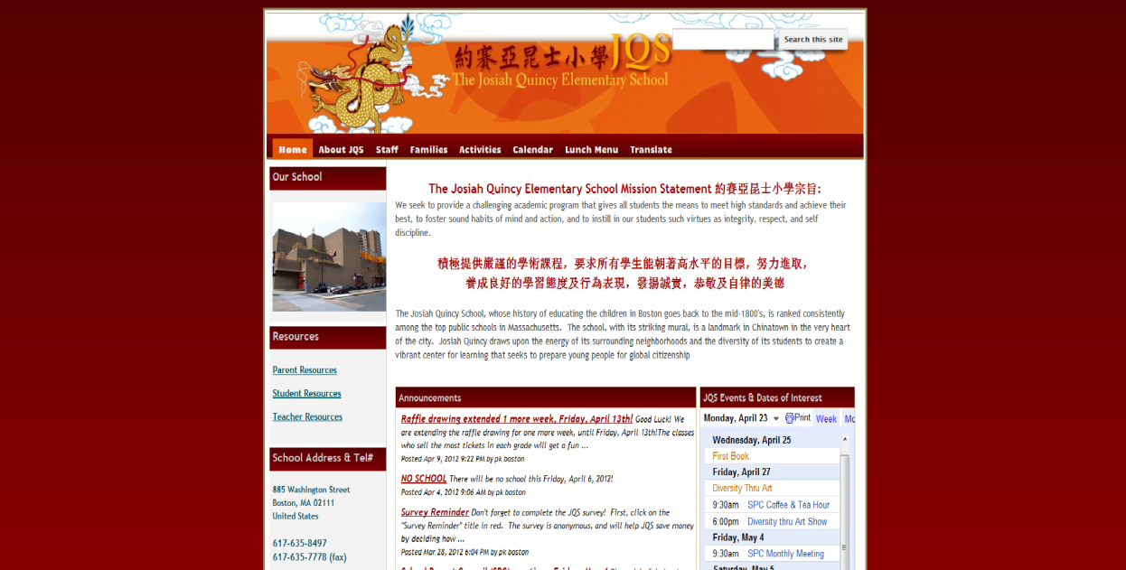
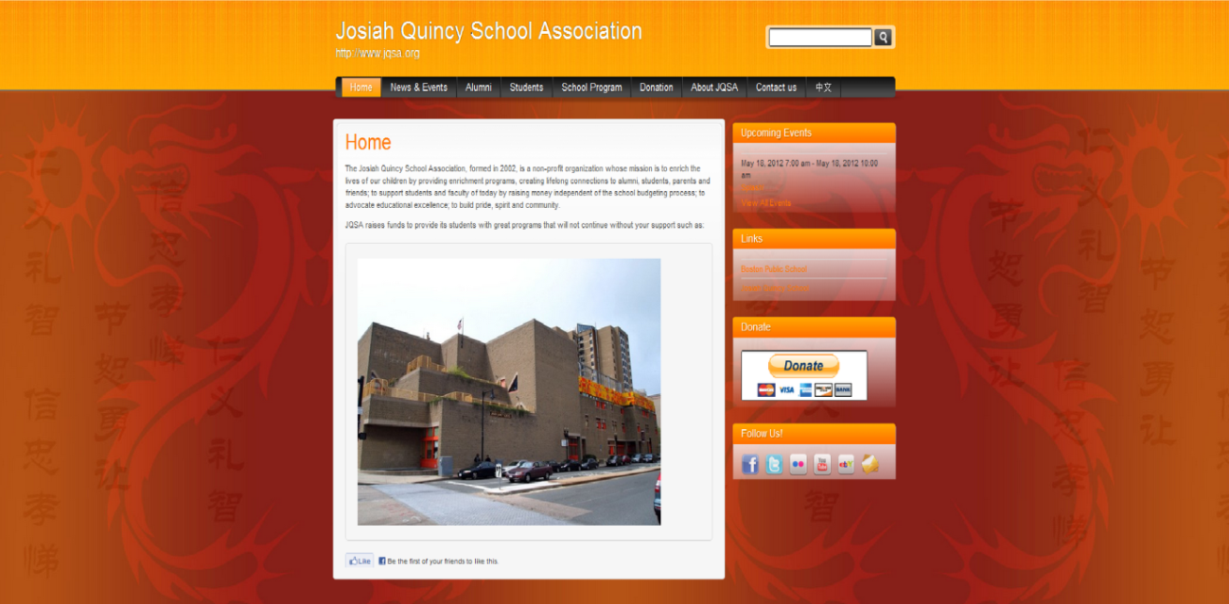
JQS Web Page Theme
JQS Layout
JQS Colors
Background
Banner

Slide 4
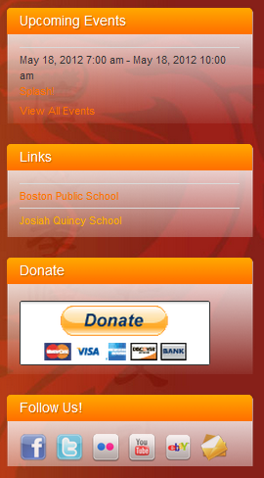

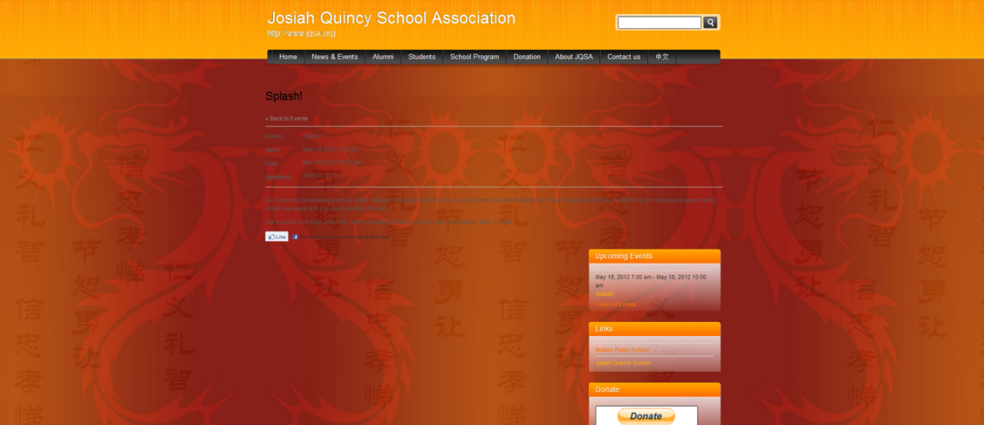
Banner
Upcoming Events
Social Media
Links
Events

Slide 5


Slide 6
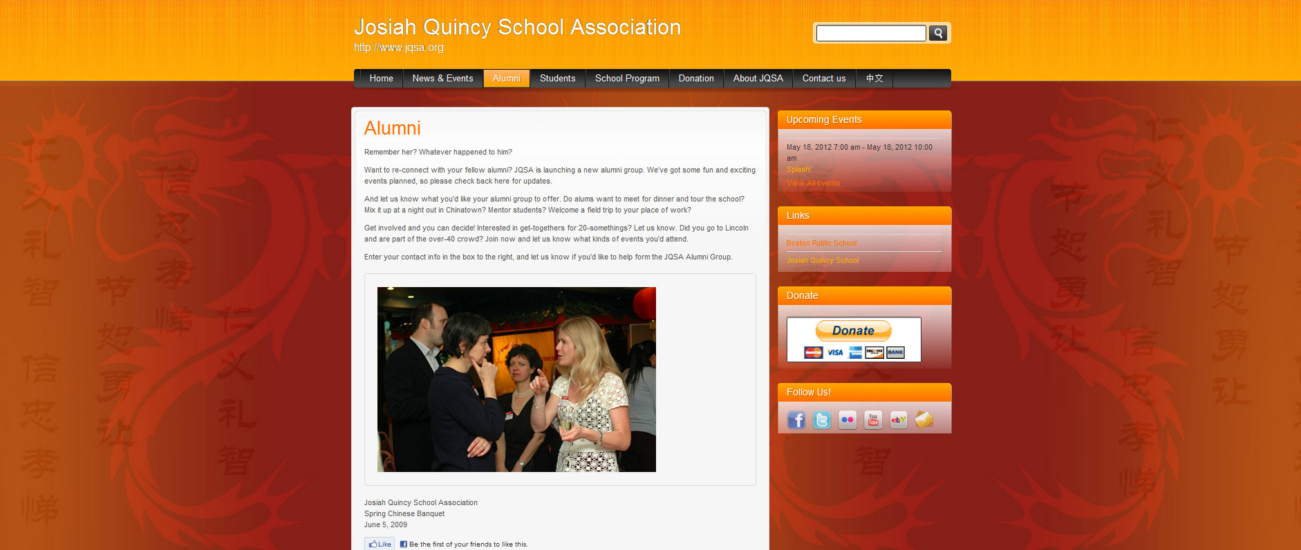
Alumni Paragraph
Pictures
Descriptions
Facebook Like

Slide 7
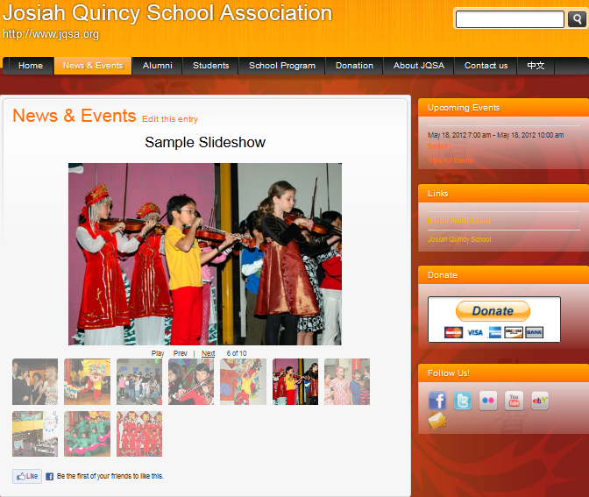
Slide show

Slide 8
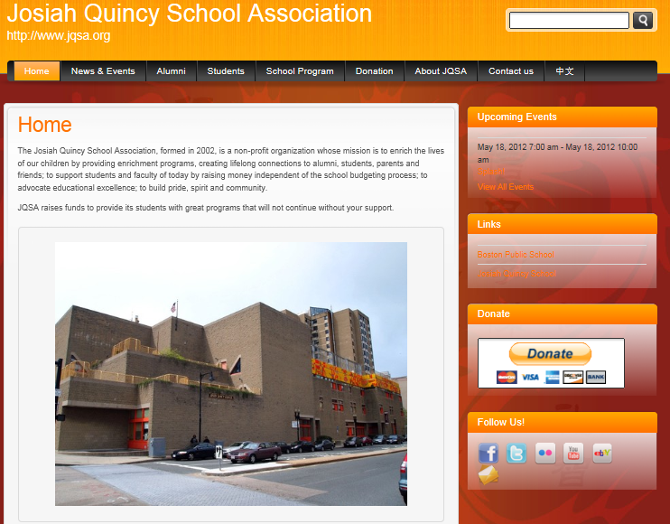

Slide 9
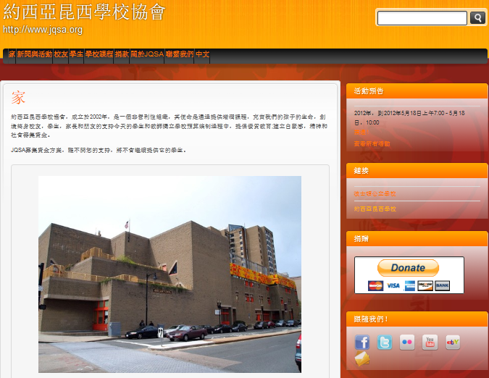

Slide 10
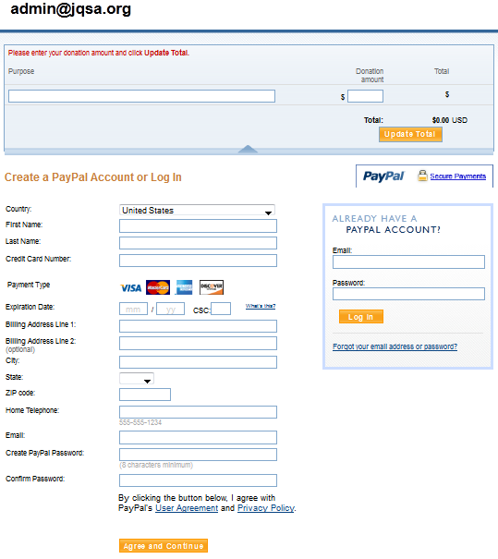
Donate Button Link

Slide 11
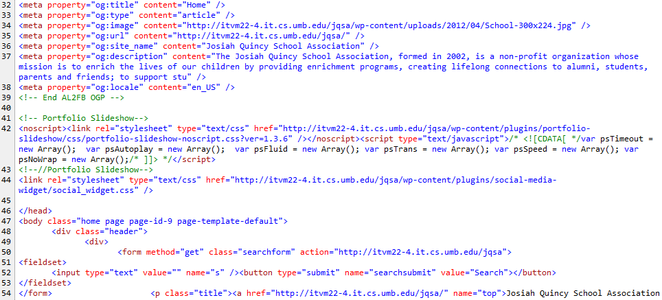
HTML

Slide 12
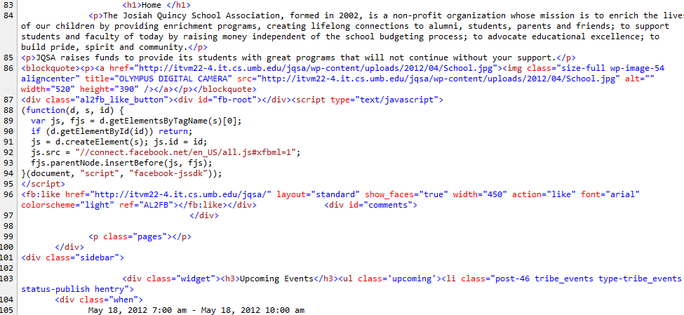

Slide 13
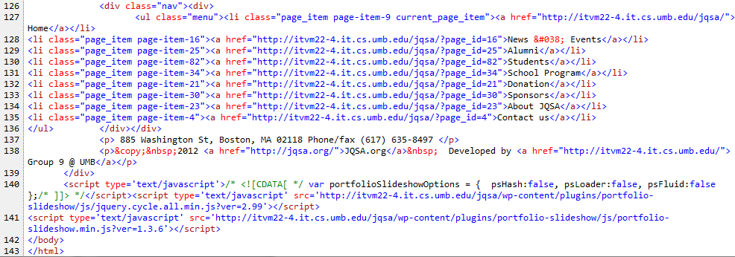

Slide 14

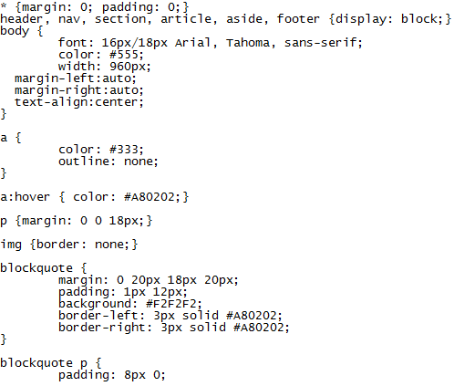

Slide 15
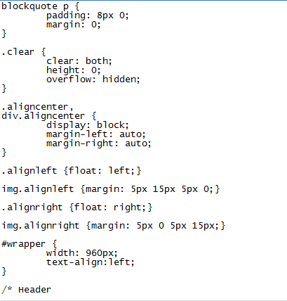

Slide 16
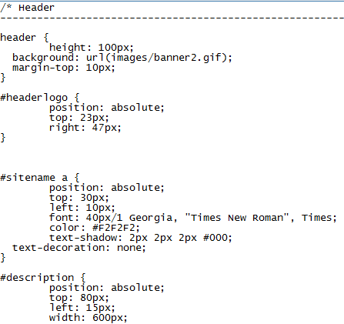

Slide 17
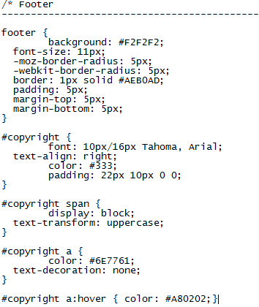

Slide 18
Outstanding Futures
Design
Translate future
PayPal secure Donation Button
Slide shows
User friendly CMS – Wordpress
Social Media Buttons
http://itvm22-4.it.cs.umb.edu/jqsa/

Slide 19
Site Map
JQSA Home
News $ Events
Alumni
Students
School Program
Donation
Sponsors
About JQSA
Contact Us
Events calendar

